Slide 1

INVESTMENT PASSPORT
city district
Shchelkovo

Slide 2
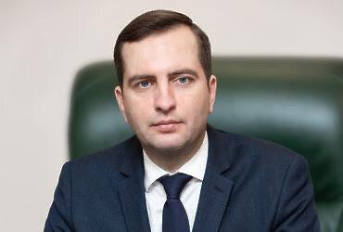

Shchelkovo city district of Moscow region is a Russian region with a rich cultural heritage, well-developed industry and agriculture, with a strong scientific base and qualified personnel.
Shchelkovo urban district is located in the North-East of the Moscow region, the distance from Moscow ring road (min/max) 12/60 kilometers.
The total area of 621 sq km, much of which is Klyazma-Meshcherskaya lowland (area of Shelkovo city – a total of 8.74 hectares.)
The urban district of Shchelkovo includes settlements:
Shchyolkovo; * Monino
Grebnevskoy; * Ogudnevskoe
Zagoryansky; * Fryanovo;
Medvezhye-Ozerskoye; * Trubinskoye
80 settlements, including 27 settlements with a population of more than 300 people
LADIES AND GENTLEMEN! (INVESTORS).
I welcome you on the pages of the information portal " Investment passport of the city district of Shchelkovo. We are confident that this project will not only be useful, but will also become a kind of guide for business people, potential investors who want to establish economic ties with the city district of Shchelkovo.
To ensure economic growth and improve the quality of life of the population of the city district Shchelkovo we have defined a strategy for the development of the municipality. The municipality has approved programs of social and economic development in such areas as education, entrepreneurship, physical culture and sports, ecology and environmental protection, development of road transport complexes, architecture, young generation, energy conservation, gasification.
Investment passport, will help you understand the full potential of the city district Shchelkovo. We are ready for dialogue with potential investors and will support projects and proposals aimed at the development of the Shchelkovo urban district. District of the city of Shchyolkovo is open to active and mutually beneficial partnership. We are waiting for interesting offers from reliable partners.
Head
city district Shchelkovo
Moscow region
Andrei Alekseevich Bulgakov
Head
city district Shchelkovo
The population of the city district Shchelkovo on January 1 2024 according to the Federal state statistics service for the Moscow region is 218.3 thousand people

Slide 3
Shchelkovo urban district is located in the North-Eastern part of the Moscow region, bordered in the South by Balashikha urban district, in the West by Korolev urban district and Ivanteevka urban district and Pushkin district, in the East by Bogorodsky urban district, Chernogolovka urban district and Losino-Petrovsky urban district, in the North by Krasnoarmeysk urban district and Vladimir region. The city district is home to 218.3 thousand people potential consumers of products
География
160 кm
Vladimir
МOSCOW
10кm
Shchelkovo
250 кm
Yaroslavl

Slide 4
Demographics and resources
The area of the city district Shchelkovo Moscow region 62.1 thousand hectares. •Administrative center — the city of Shchelkovo. * Composition of the district-8 settlements: 4 urban, 4 rural . * Population-218,3 thousand people (as of 01.01.2024) Urban area-179 thousand people rural area-39,9 thousand people administrative center-118,962 thousand people * Able-bodied population-128,8 thousand people. the economy of the district employs-42 thousand people. Due to the pendulum migration, there is a personnel reserve of skilled labor of the order-7,0 thousand people.
Minerals: the city district is rich in Minerals. The most important Deposit is dolomite, located in the Central part of the city district. In 1972, a well was drilled on the territory of the sanatorium "Monino" and underground mineral waters were discovered, which are successfully used for the treatment of gastrointestinal diseases.
Average monthly salary (thousand rubles))
• industry-98,4 • education-67,4
• rural economy-75,5 • health – 75,6
• culture and sports-66,1
• trade – 77,7
The cadastral value of land plots for placement * housing and communal services: from 50 thousand to 250 thousand rubles per sq. m. * suburban and horticultural associations: from 839,0-up to 2 948 rubles per sq. m. * objects of trade: from 45 thousand to 150 thousand rubles per sq. m.

Slide 5



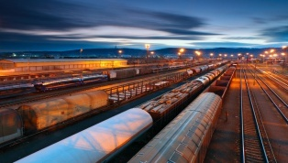


Transport links
The city district of Shchyolkovo is intensively developing and improving, respectively, passenger traffic is growing, road and route networks in the district are changing. Transport service of the population on the routes of regular transportation is provided by 7 carriers. Every day, about 400 buses come to the line, which serve 54 routes with a total length of 2040 km. 75% of flights are made by public transport, with the provision of benefits to the population. The main carrier of passengers in the city district remains the «Mostransavto» branch of the Motor company 1785.
Road transport-7 transport organizations
Main highways: A103, P110
The presence of freight rail stations: Shchelkovo and Sokolovsky
Length of highways : 922 km (including 38.1 km of Federal significance).
The presence of airfields – the airfield Chkalovsky

Slide 6
Education
97 municipal institutions in the field of education
45 preschool educational institutions
13 institutions of additional education
1 institution of additional professional education " Educational and methodical educational center "(MBU DPOUMOTS)
General education-30 institutions
1 gymnasium, 2 lyceums, 2 schools with in-depth teaching of individual subjects, 21 secondary schools. 2 basic secondary schools, 1 special (correctional) secondary school.
TOP-100 "Best schools of the Moscow region": Shchelkovo gymnasium and school No. 11. G. S. Titova
TOP 500 "Best schools in Russia": Shchelkovo gymnasium. Laureate of the regional competition " standard of registration of educational organizations – - school No. 12. V. P. Chkalova
Early childhood education – 45 kindergartens
total there are more than 12 thousand children in kindergartens
5 kindergartens with swimming pools
3 buildings of kindergartens (355 places) were put into operation)
open an additional 7 groups (150 seats)
11 child development centers
19 preschool educational institutions of General developmental type with priority implementation of activities in one of the areas of child development
Additional education-13 educational institutions
4 multidisciplinary centers
2 music schools
5 children's art schools
1 art school
1 choreographic school
Experimental activities together with scientific institutes-5 institutions.
All-Russian military-Patriotic movement "Unarmy»

Slide 7
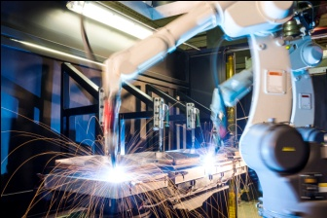
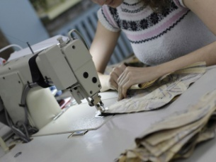

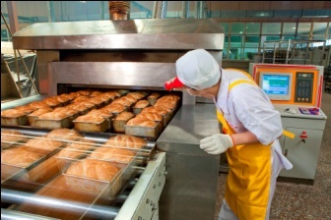
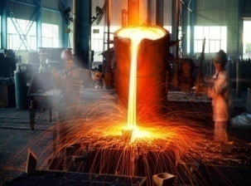
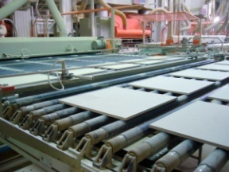
Industrial complex
The basis of the real sector of the economy of the city district is the industrial complex. It is more than 40 large and medium-sized enterprises, employing more than 43 thousand employees
44
million pack
504
million. conditional cans
2,5
thousand pieces
37
thousand tons
1,8
million sq.m
7,5
million sq.m
Production of machinery and equipment
Textile and clothing production
Chemical production
Food and non-processing industry
Metallurgical production
Non-metallic mineral products

Slide 8




Industrial potential
9380
11492 ед.
Number of economic entities in the city district
224585,38
ELECTRICITY CONSUMPTION ALL KINDS OF CONSUMERS, MW / YEAR
365767656,7
GAS CONSUMPTION BY ALL CONSUMERS, CUBIC METERS / YEAR
Commercial enterprises not related to small and medium-sized enterprises
198 ед.
Small and medium-sized enterprises, including micro-enterprises
11284ед.
975748,52
HEAT ENERGY CONSUMPTION BY ALL KINDS OF USERS, GCAL / YEAR
16433500
WATER CONSUMPTION BY ALL AGES CONSUMERS', CUBIC METERS / YEAR
Basic industry
107923,1
MILLION RUBLES Shipped goods of own production, performed works and services on their own
17260,7
MILLION RUBLES Investments in fixed assets from all sources of financing
11384,9
MILLION. RUB.
Profit
2773,8
MILLION RUB.
The volume of sales of paid services to the public
38330,8
MILLION RUB
Chemical industry
4 units
46315,7
MILLION RUB.
Retail trade turnover
31918,2
MILLION RUB.
10 units
Food production, including beverages
6179,2 Production of machinery and equipment 5 units.
MILLION. RUB.

Slide 9
List of investment projects under implementation
№ п/п | Investor | Project name
1. | LLC «Russian grocery company» | Reconstruction of the plant for the production of sauces, spices and seasonings
2. | JSC «Gazprom Space systems» | The construction of a plant for the manufacture of satellites
3. | LLC «TPC «ZEDEX» | Construction of the INKULEN PE-500 materials manufacturing plant (1000 , 9000)
4. | LLC «Kronopharm Industries» | Construction of a production site for hormonal medicines
5. | LLC «TECHENERGOGROUP» | Construction of a plant for the production of electrical equipment
6. | LLC «GRC» | Construction of a scientific, production and repair complex

Slide 10

Priority sectors of development of the district to attract investment
Economic development of the city district Shchyolkovo
«Relocation of citizens from emergency housing stock»
«Construction of social infrastructure facilities»
«The formation of a modern urban environment»
The set of interrelated municipal programs adopted for implementation serves as a tool for re-regulation and management of the municipal strategy of social and economic development. Programs implemented in the city district of Shchelkovo in 2024.
«Еducation»
«Development of engineering infrastructure and energy efficiency»
«Agricultural development»
City district Shchelkov
«Safety and ensuring the safety of life of the population»
«Entrepreneurship»
«Social protection of the population»
«Security of the city district Shchelkovo»
«Sport»
«Architecture and urban planning»
«Сulture and tourism»
«Healthcare»
«Development and functioning of the road transport complex»
«Ecology and environment»
«Housing»
«Property and municipal finance management»
«Digital Municipality»
«Development of civil society institutions, increasing the effectiveness of local government and the implementation of youth policy»

Slide 11

Business
NUMBER OF SUBJECTS SMALL AND MEDIUM BUSINESSES'
IN TERMS OF 10 THOUSAND. PEOPLE
ECONOMIC DEVELOPMENT OF THE SHCHELKOVO URBAN DISTRICT
The law on contract service gives small businesses greater access to Municipal order Active participation of actors (and this should be 15% co- total annual volume procurement) - one of the conditions creating a long-term basis for business development in the city district
Industrial output
Building complex
Housing and communal services
Agribusiness
Consumer services
Provision of paid social services
Support for innovative projects that ensure the production of fundamentally new products
516,9
PRIORITY DIRECTIONS OF DEVELOPMENT OF SMALL AND MEDIUM ENTERPRISES
SUPPORT FOR SOCIAL ENTREPRENEURSHIP
SUPPORT FOR HIGH-TECH AND INNOVATIVE COMPANIES
On the territory of the city district Shchelkovo on January 1 2024 there are more than 11 thousand small and medium businesses
SMALL BUSINESS PROVIDING FINANCIAL SUPPORT TO SMALL AND MEDIUM-SIZED BUSINESSES, THOUSAND RUBLES
INDICATOR
2023
BUDGET FUNDS OF THE CITY SETTLEMENT OF SHCHELKOVO
1 465,1
THE TOTAL AMOUNT OF FINANCIAL SUPPORT
1 465,1

Slide 12
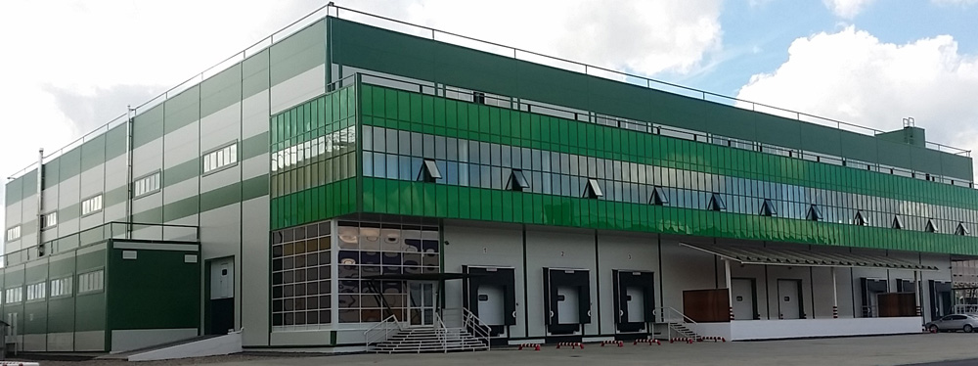
Engineering and technical characteristics of the industrial Park
«TECHNOPARK»
The total area for the placement of the Technopark is 11.6 hectares
land plots from 0.3 to 1.5 hectares
Land ownership is private
Еlectric power 1.2 megawatts
Autonomous heat supply
Аvailability of buildings: Yes
Distance to the railway station-3 km.
Permissible SPZ-50 m.
Water supply 30 cubic meters per day
Park representative contacts:
Name: Pantyuk Dmitry Alexandrovich
Phone number: 8 (903)157-01-07
Email: drtex@yandex.ru

Slide 13
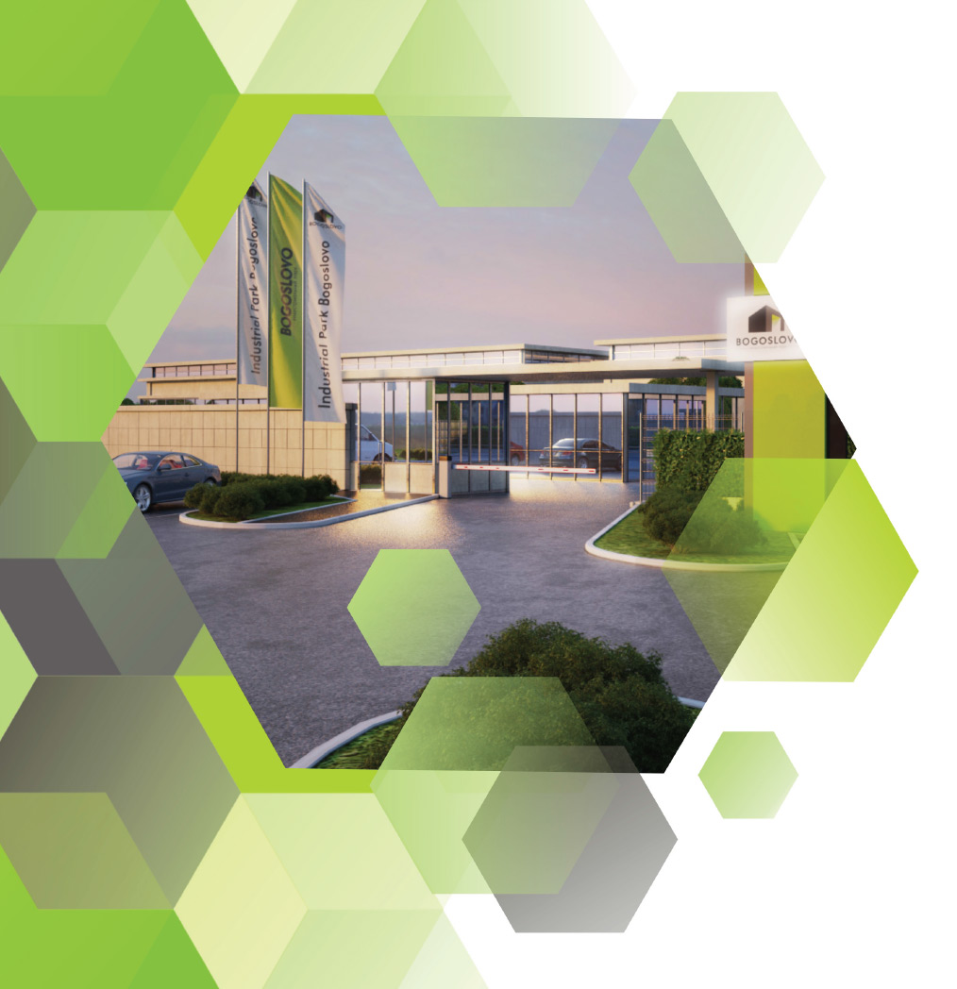
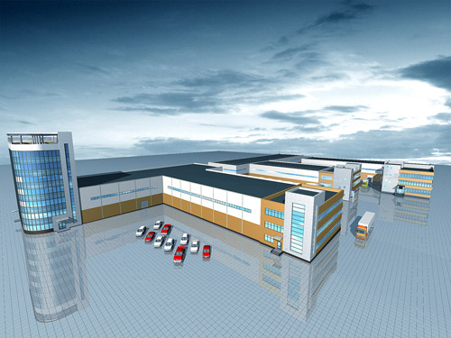
INDUSTRIAL PARK "BOGOSLOVO»
The total area for the placement of the Technopark is 9.7 hectares
land plots from 0.2 to 1.9 hectares
Land ownership is private
Engineering and technical characteristics
of the industrial Park
Еlectric power 0.8 megawatts
Gas supply-400m. cubic meters / hour
Heat supply-4MW
Distance to the railway station-5 km.
Permissible SPZ-50 m.
Water supply 30 cubic meters per day
Park representative contacts:
Name: Svetlana Viktorovna Lebedeva
Phone number: 8(966)108-78-25
Email: lebedeva1966@rambler.ru

Slide 14
Promising land plots for investment
INDUSTRIAL SITE «134»
Cadastral number 50:14: 0030214:134
Location | City Schelkovo district, s/p Grebnevskoy, near the village of Saburovo
Category | Lands of agricultural destination
Type | Storage and processing of agricultural products
Area (sq. m) | 5 007

Slide 15
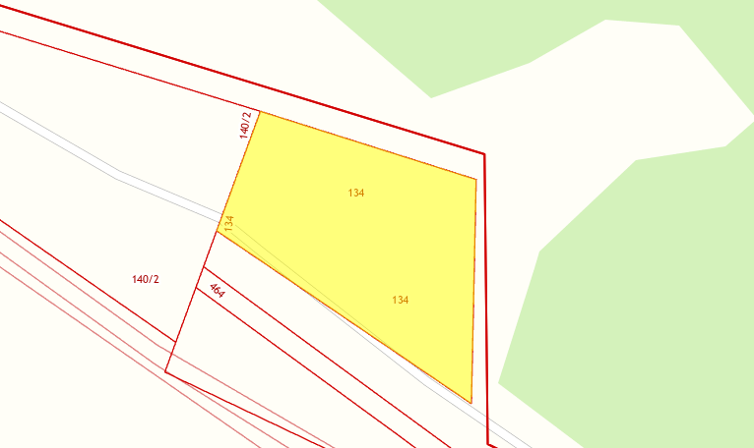

Slide 16
Promising land plots for investment
INDUSTRIAL SITE «153212»
Cadastral number 50:14:0000000:153212
Location | Shchelkovo urban district, near the village of Bobry
Category | Agricultural land appointments
Type | animal husbandry
Area (sq. m) | 355 633

Slide 17
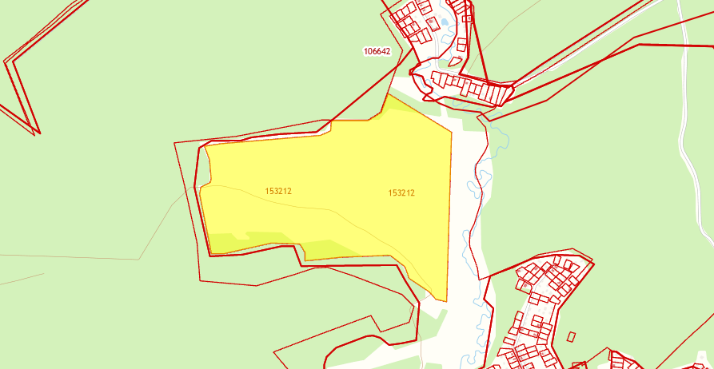

Slide 18
Promising land plots for investment
INDUSTRIAL SITE «1129»
Cadastral number 50:14:0030210:1129
Location | Shchelkovo city district, Bogoslovo
Category | Lands of settlements
Tapy | Production activities
Area (sq.m) | 6 541

Slide 19
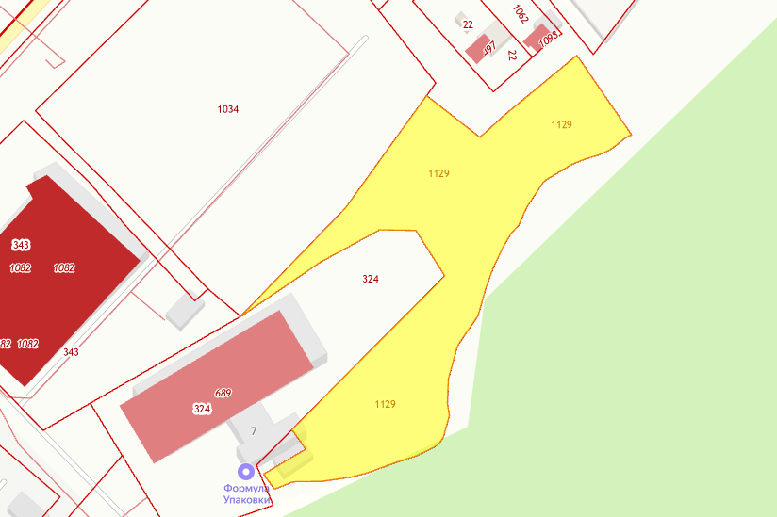

Slide 20
USEFUL INFORMATION FOR INVESTORS
Administration of the city district Shchelkovo Moscow region
Address: 141100, Moscow region, Shchelkovo city district,
Lenin square, 2.
Department of investments of administration of the city district Shchelkovo:
phone: 8(496)561-11-61
email address: investotdel@shhyolkovo.ru

